Slide 1
Big Mountain Resort Financial Report

Slide 2
Problem Statement
Big Mountain Resort in Montana charges higher than average prices compared to other resorts in its market, but does not have enough data about which facilities contribute to this premium cost. The resort offers many amenities, spectacular views, and is accessible to all skill levels. They would like to know the relative importance of the facilities offered to inform decisions about the future of the facilities offered by the resort.

Slide 3
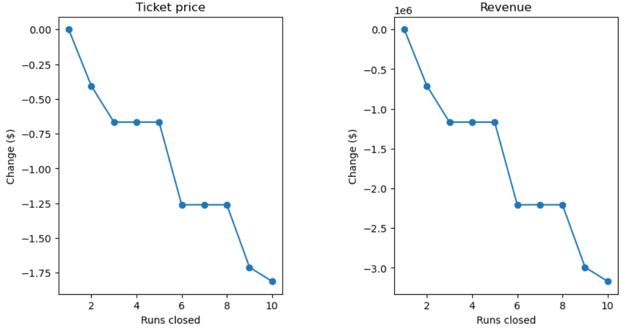
Recommendation
Raise Ticket Prices $7.00
Close 5 of least used runs
Add new run with a Vertical Drop of 150ft
Add new Chair Lift to this new run
Ticket Price Impact
Closing 3-5 Runs: -$0.70/ticket (-$1,225,000/yr)*
Closing 6-8 Runs: -$1.25/ticket (-$17,500,000/yr)*
Opening New Run, Increasing Vertical Drop 150ft, Adding New Chair Lift:
+$1.99/ticket (+$3,474,638/yr)**
*Revenue figures calculated by assuming 350,000 visitors per year with a 5 day pass **Chair Lift Yearly Costs: $1,540,000 per year

Slide 4
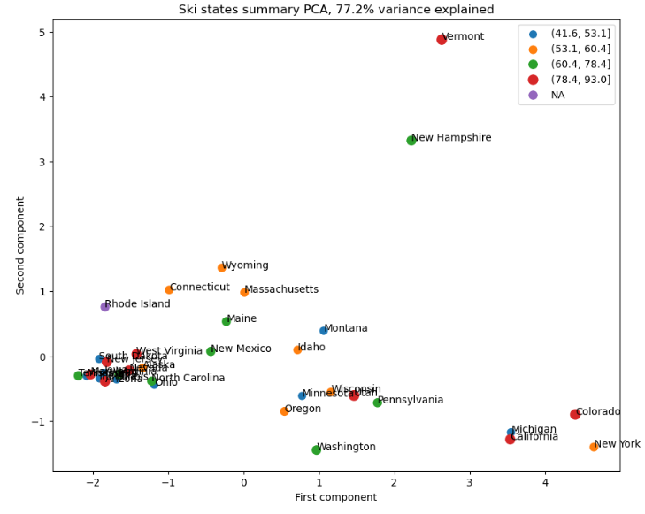
Modeling Data
277 of 330 resorts across America were analyzed (14% were missing ticket price data)
State Analysis
Resorts were grouped by state and analyzed
The factors that most varied between each state did not correlate with ticket price variance
The factors that varied between states were mostly related to the number of resorts per 100k residents, and number of resorts per 100k sq. miles
In other words, small states such as Vermont and New Hampshire with lots of skiing vs. Large states with little skiing such as California and New Mexico
State factors are unclear and need further analysis

Slide 5
Modeling Data
Linear Regression
Median Imputation:
MAE: 8.55 - 9.40 (-0.85)
R^2: 0.817 - 0.721 (-0.96)
Mean Imputation:
MAE: 8.54 - 9.42 (-0.88)
R^2: 0.816 - 0.716 (-0.10)
Overfit Model: Less Error Score for test data vs. train data. Linear Model cannot predict new data as well.
Cross Validation Tests:
Linear Regressor:
Cross Validation Variance: 0.09 MAE: 10.49
Random Forest:
Cross Validation Variance: 0.05 MAE: 9.64
Random Forest performs more consistently at predicting new data and Random Forest was $0.85 better at predicting ticket price

Slide 6
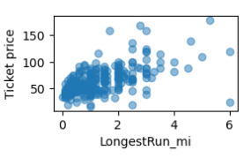
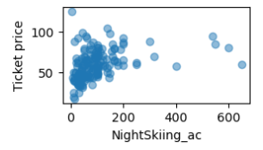
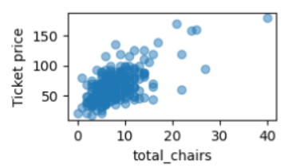
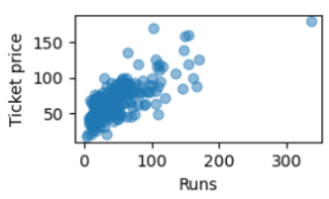
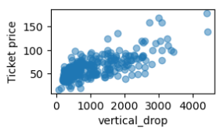
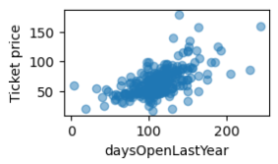
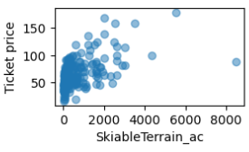
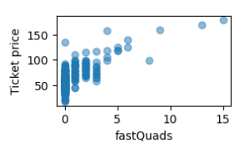
Modeling Data
Resort Analysis - Positive Indicators!
LongestRun (mi),
NightSkiing (ac),
Total Chairs,
# of Runs,
Vertical Drop,
fast Quads,
Skiiable Terrain (ac),
Days Open

Slide 7
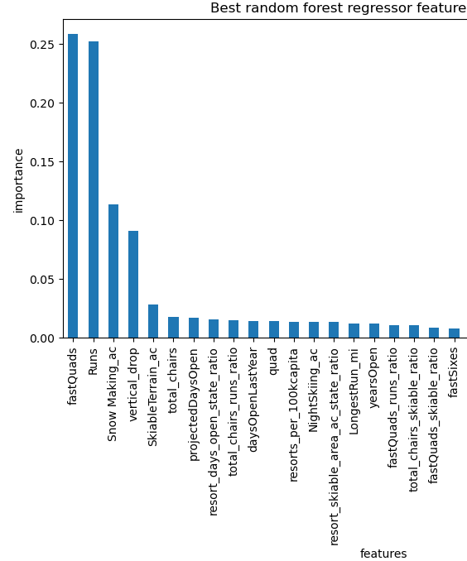
Key Findings
Big Mountain Resort Tickets are underpriced by between $4.50 and $25.26 ($14.89 with MAE of $10.39)
Most important features to raise ticket price:
fastQuads
Number of Runs
Snow_Making acres
Vertical Drop (ft)

Slide 8
Conclusion
While analysis showed there is enough data, the model could still incorporate:
Resort Visitorship Data
Granular Daily Visitorship and Ridership Data
Macroeconomic Factors
With this Data, the model will be enhanced:
Further Fine Tune Hyperparameters
Increased Efficacy of Predictions
Increased Detail of Predictions

